Slide 1
BLOCKCHAIN REWARD SYSTEM
A Portal to generate and distribute reward tokens

Slide 2
TABLE OF CONTENTS
01
02
03
Problem overview
Solution analysis
Tech-stacks Used
04
05
06
Implementation
Future Scope
Conclusion

Slide 3

Web 3.0 World
“Blockchain technology isn't just a more efficient way to settle securities. It will fundamentally change market structures, and maybe even the architecture of the Internet itself.”
-Abigail Johnson

Slide 4
01
PROBLEM OVERVIEW
Our Explanation and understanding of the Problem

Slide 5
PROBLEM VS. SOLUTION
Problem
Solution
Currently there is no de-centralised way of prize distribution for winners of various competitions and often prizes are delayed.
Building a webapp which acts as a reward distribution portal where tokens are generated which can later be encashed for various commodities

Slide 6
MAIN COMPONENTS
Authentication
Admin User
Decentralised
Only verified users can transfer their tokens or exchange them.
Only a verified admin can generate tokens and allot them and create list of prizes.
The whole token system should be decentralised via use of blockchain

Slide 7
02
SOLUTION ANALYSIS
How we propose to solve the problem

Slide 8
Solution Pipeline
Admin Login and student login using google auth
A student will have his tokens in his metamask account
A student can transfer their token to other students
Authentication
Student
Transfer
Create Token
Redeem Token
The admin user can create tokens, allot them and create list of prizes
Student can use tokens to redeem prizes from list of prizes

Slide 9
03
TECH-STACKS USED
Various tech-stacks used for our implementation

Slide 10



Tech-stacks & Technologies
React js
We used react js for implementation of frontend
Ethereum
We used solidity to integrate smart contracts on ethereum blockchain
Firebase
We used firebase for web-app authentication

Slide 11
04
IMPLEMENTATION
Things which we implemented and achieved

Slide 12
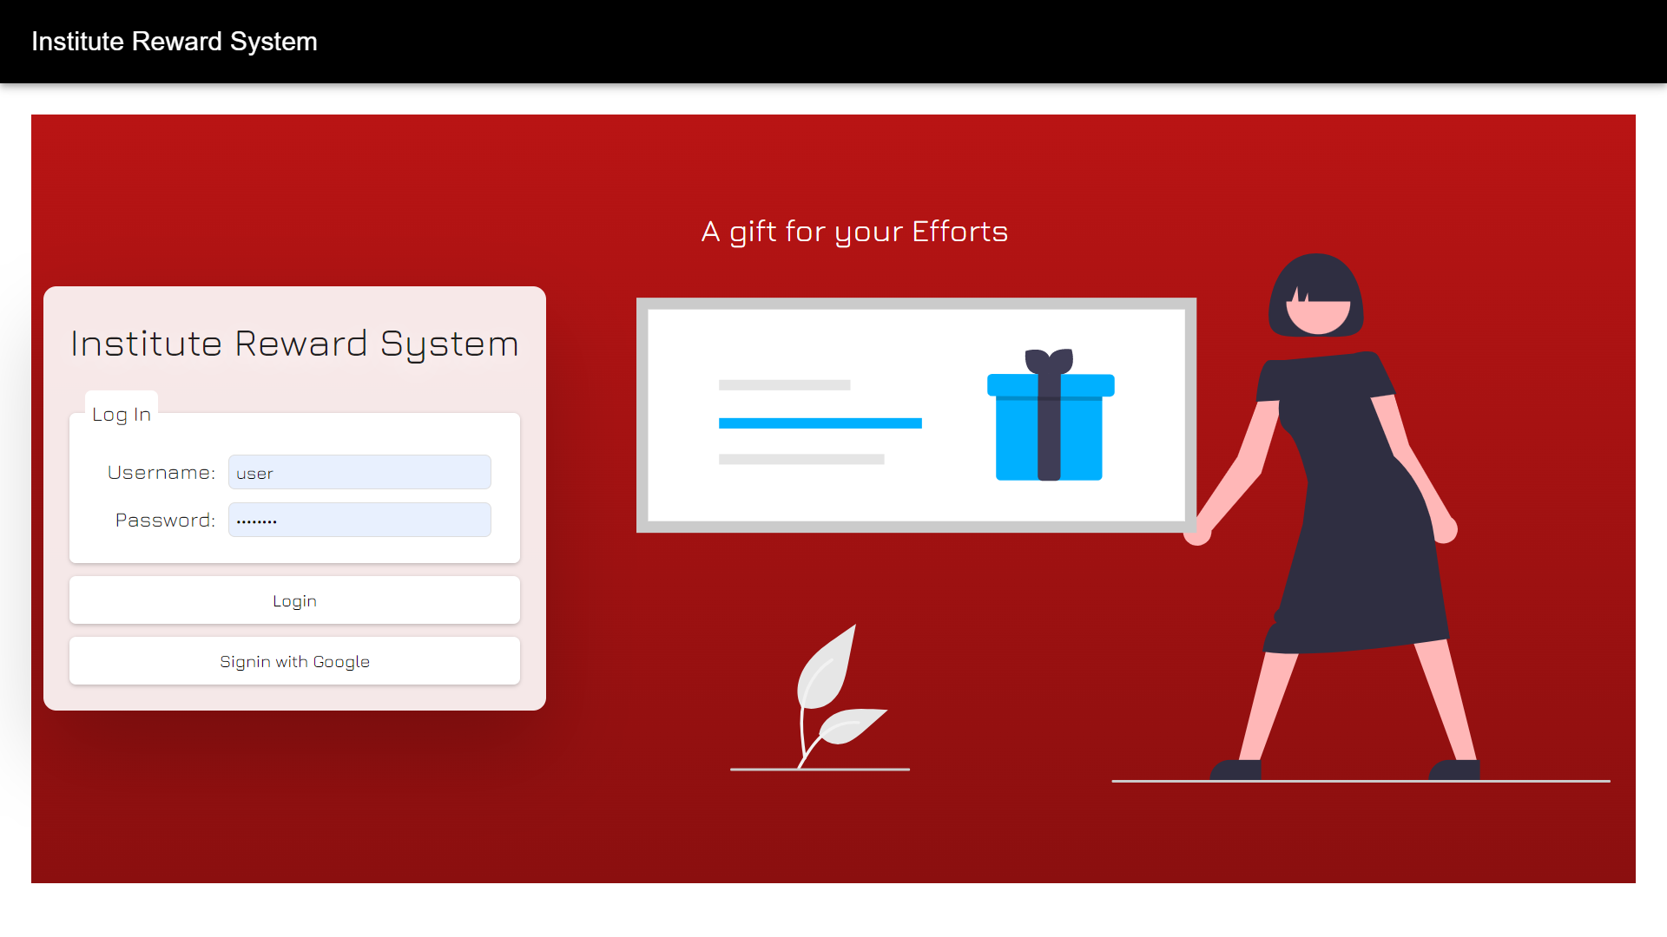

Slide 13
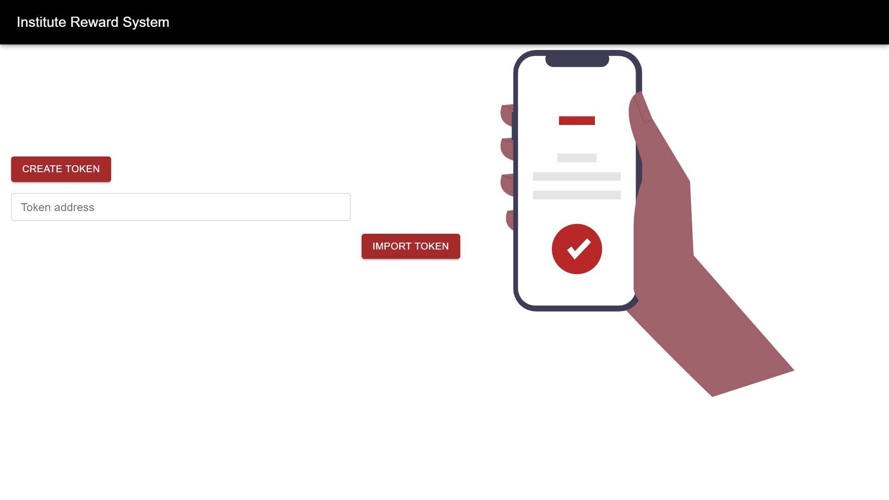

Slide 14
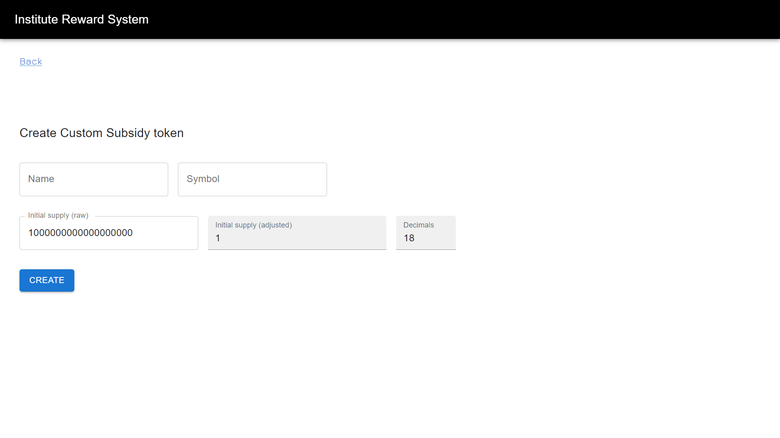

Slide 15
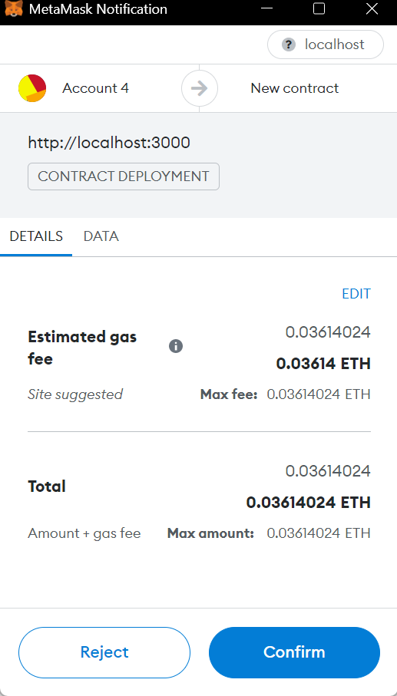

Slide 16
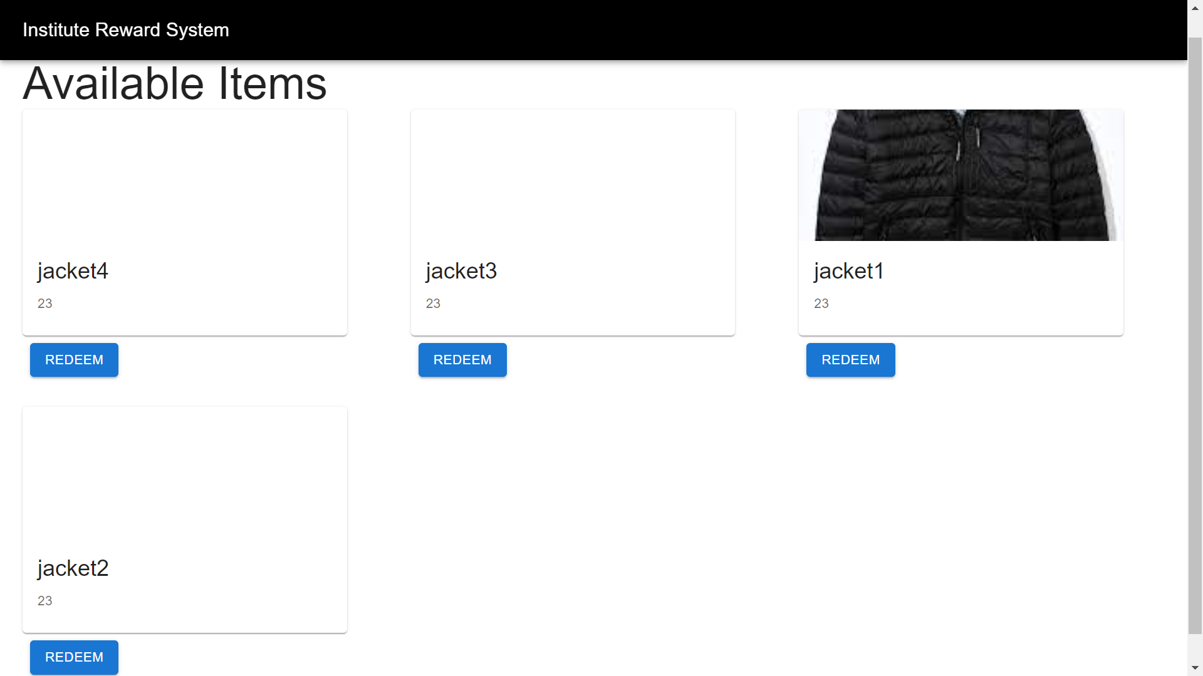

Slide 17
05
FUTURE SCOPE

Slide 18
Things that can be implemented
Implementing taxation system as described in the problem statement
Adding functionality of creating and accessing metamask account on the web-app interface
Storing user information on blockchain instead of firebase.

Slide 19
06
CONCLUSION

Slide 20

PROJECT ACCESS
GITHUB LINK: https://github.com/drraghavendra/Incentive-Reward-System

